Slide 1
The Complete Front-End Development course
Introduction

Slide 2
FAQs
Who can take this Course?
What is included in this Course?
What will you gain from this Course?
How is this Course going to help you in your path to Masters or PhD?
How is this Course going to help you get a Job?
Theory or Hands-on Practical teaching?

Slide 3


Slide 4
Module 1
How does the internet work?
What are websites and how do they work?
The Browser and HTTP.
How have web applications evolved- Web 1.0, 2.0, 3.0
Fundamentals of web application design- The N-tier architecture.
Role of HTML, CSS and JavaScript.
Set up the Software Development Environment you will use throughout the course.

Slide 5
Why learn to create Web Applications?
Websites and Web Applications help businesses. Offline to Online or Fully Online
Evolving business challenges require technology solutions as business grows.
Custom web application development solutions can automate business processes and provide a superior ROI to investments.
Eg. 1mg, healthifyme, Social Media, ecommerce, Delivery Services, Financial online services, Entertainment sites, Travel booking websites, Communication services.

Slide 6
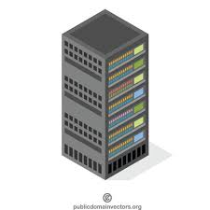

How does the Internet work?
A line with many computers connected to each other. Some have to be online 24*7 - Web servers.
Servers are just like libraries open all day for us to request any book (websites) and read any of its page (webpage).
Server
The Internet
Internet Service Provider
DNS Server
Client
Notes:
https://www.submarinecablemap.com/

Slide 7
Basic Network Ideas
Application
DNS, HTTP
Transport
TCP (Transmission Control Protocol)
Network
IP (Internet Protocol)
Network interface
Ethernet
4 layers Protocols/Services for a Web Application

Slide 8
https://www.facebook.com/
scheme://prefix.domain:port/path/filename
Type of Internet service
Domain prefix
Internet domain name
Port number at the host (default for http is 80)
Path at the server (If omitted: the root directory of the site)
The name of a document or resource

Slide 9
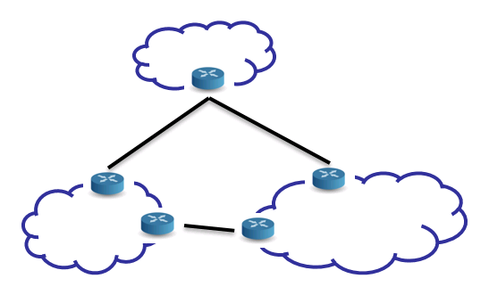

129.51.150.10
Modem
Firewall
Domain Name Server
Google.com -> 64.233.171.1
ISP
Router
Internet Backbone
Google Web Server
64.233.171.1

Slide 10
The Browser and HTTP.
Data is sent and received in packets in TCP/IP.
Packet:
Web operates on top of the internet via HTTP (Hyper Text Transfer Protocol).
www is a system of interlinked webpages accessed via the internet.
HTTP is a stateless protocol.
Browser is a piece of Software that allows to lookup IP address, to send and receive data.
Data
Source: 129.51.150.10
Destination: 64.233.171.1

Slide 11

What are websites and how do they work?
Any book in the library of www with all of its pages (webpages) is a website.

Slide 12
How have web applications evolved
Web 1.0
Web 2.0
Web 3.0
Intelligence

Slide 13
















Web Application Architecture
http request
http response
Front-End
Middleware
Database

Slide 14
Web 2.0
N tier Architecture
Separation of Concerns
Client (Browser)
Web
Presentation
Business Logic
Data Access (Connector)
Data (Database)
HTTP Request over the network.
6 Tier Architecture

Slide 15



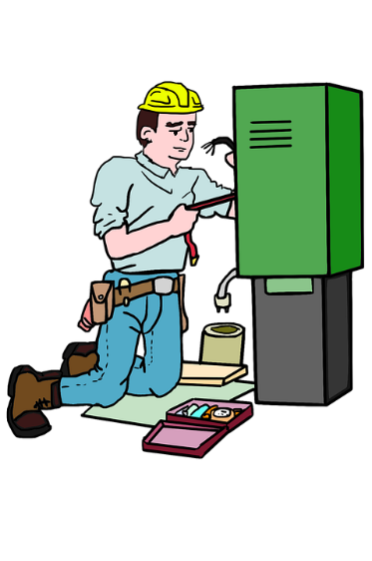


Role of HTML, CSS and JavaScript.
Structure(HTML), Style(CSS) and Behavior(JavaScript)
Website has only few seconds to put a good impression.

Slide 16
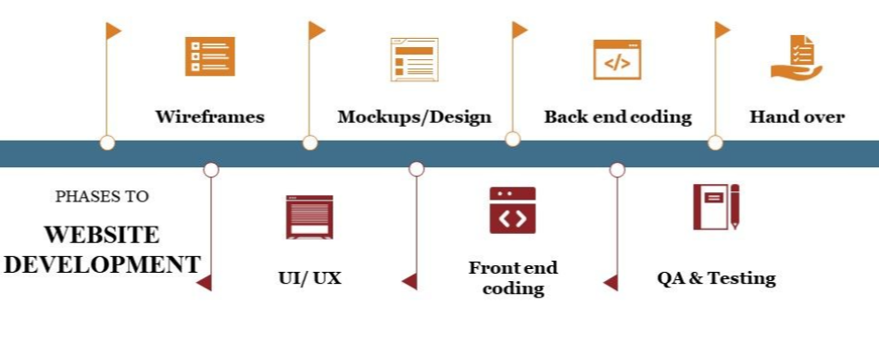
Typical tasks in Web Development
Requirements Gathering
Design Specifications
Coding
Unit testing, Integration testing
Production deployment and maintenance

Slide 17
If you wish to host your own website
Buy a Domain
Buy a hosting space from sites like GoDaddy and use ftp for upload OR
Use github pages for demonstrating static website OR
Upload your site on any Platform-as-a-service like AWS, Google Cloud Platform, Azure etc.
Use FTP or the services provided by your hosting service provider to keep your website updated.

Slide 18
Setup your local environment
Browser- Chrome (comes with chrome developer tools) and other browsers.
VS code editor with some extensions.

Slide 19
Documentation
Software Requirements Specification
Software Design Document

Slide 20
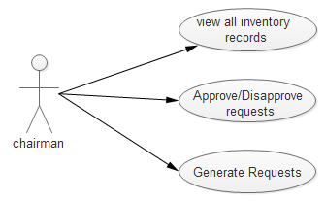
Software Requirements Specification
Purpose
Product Scope
Product Perspective- Actors
User Classes and Characteristics
Product Functions
Chairperson
History of approved / disapproved requests
-View entire inventory -Approve/disapprove requests -generate request for adding new staff or infrastructure

Slide 21
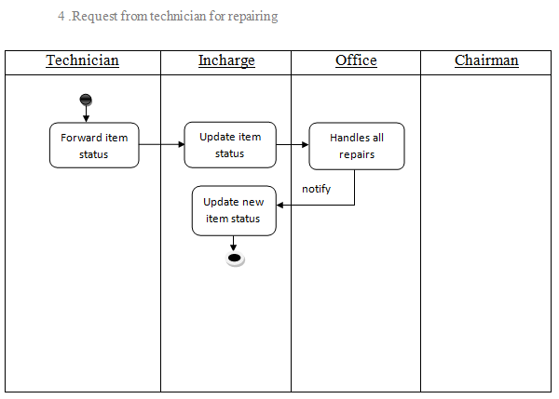
Software Requirements Specification
Activity Sequence diagrams

Slide 22
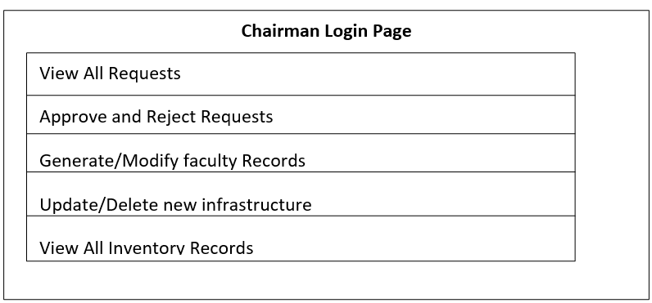
Software Requirements Specification
User Interface Design
Login Page
When login as chairman

Slide 23
Software Requirements Specification
System Features detailed
Other Non functional requirements-
Usability
Reliability
Performance
Supportability
Accessibility
Security Requirements
Other Requirements

Slide 24
How to get the most out of the course?
Pause, try yourself, check solution, rectify.
Rather than code along, listen, understand, practice and test yourself.
Make notes during lectures.
Don’t skip any module to smoothly increase your level of understanding.
Hard? Mark for review. Do again later.

Slide 25
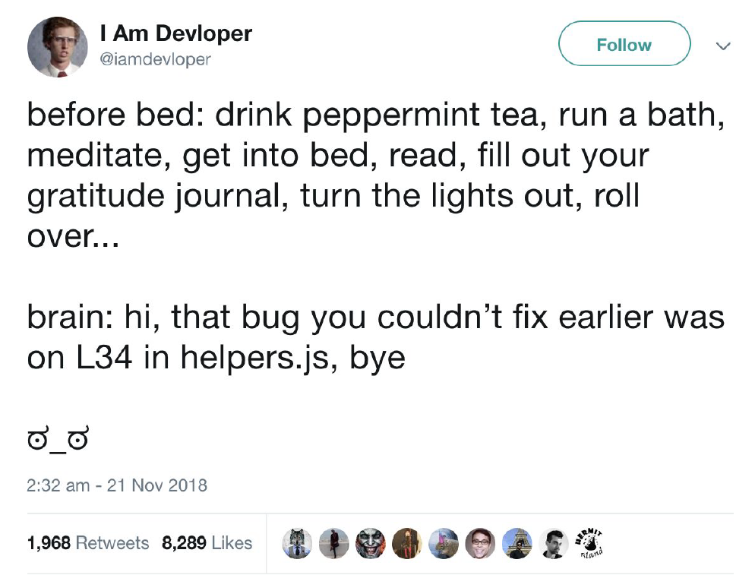

Slide 26
Summary
FAQs
Importance of web applications
Basics of internet, http and web
Basic Web application architecture
Your tasks as a developer
Knowing HTML, CSS and JS
Hosting your site
Documentation

Slide 27
Assignment
Answer the given Questions.
What are the layers of Protocols/Services for a Web Application? Explain each protocol.
Explain how a website is rendered to you when you type a website URL on a browser.
What are the differences between web 1.0, 2.0 and 3.0?
What is the difference between webpage, website, Web server, and search engine?
Match the following-
1. CSS a. Behaviour
2. HTML b. Style
3. Javascript c. Structure
Mention the typical tasks you would have to do in the development of a web application.
What is a URL?
What is a domain name?
What is a Web server?

Slide 28
Assignment
Consider the sample Software Requirements Specifications documents provided. Create your own SRS document for your ecommerce website using these samples. Consider the mockups of the website provided and include all the specifications observed in them in your SRS.

